Slide 1
Gamma Spectroscopy
Kitty Harris and Josh Eslarboukh

Slide 2
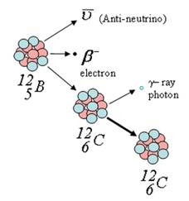
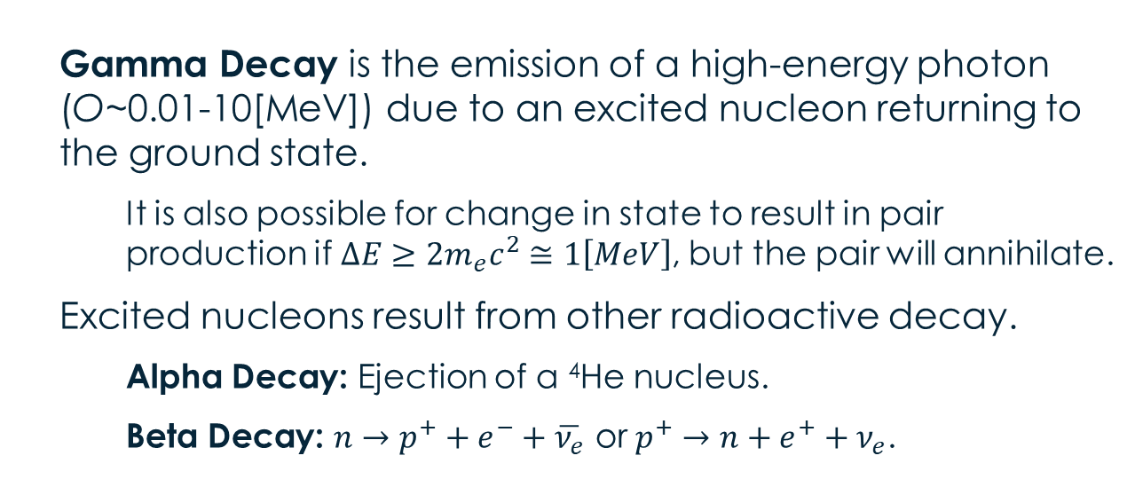
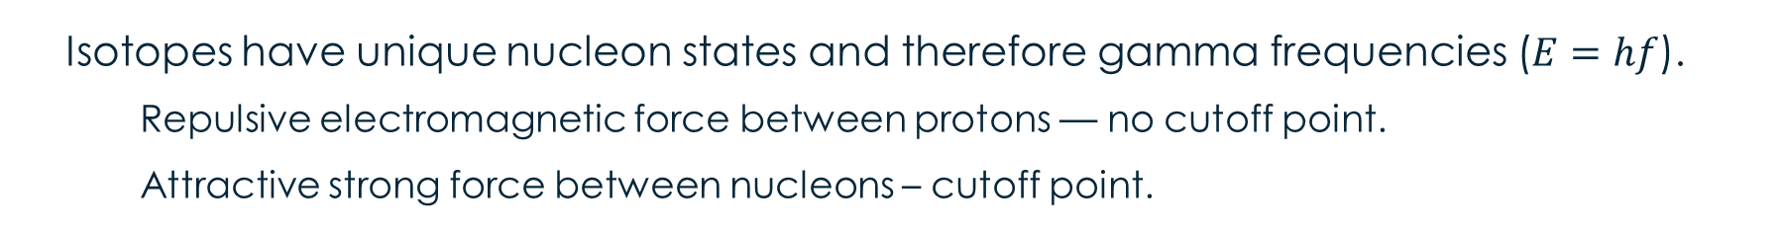
Gamma Decay
Gamma Decay is the emission of a high-energy photon (O~0.01-10[MeV]) due to an excited nucleon returning to the ground state.
It is also possible for change in state to result in pair production if$ΔE≥2m_{e}c^{2}≅1\left[MeV\right]$, but the pair will annihilate.
Excited nucleons result from other radioactive decay.
Alpha Decay: Ejection of a ⁴He nucleus.
Beta Decay: $n→p^{+}+e^{−}+\overline{ν_{e}}$ or $p^{+}→n+e^{+}+ν_{e}$.
Isotopes have unique nucleon states and therefore gamma frequencies ($E=hf$).
Repulsive electromagnetic force between protons — no cutoff point.
Attractive strong force between nucleons – cutoff point.

Slide 3
Gamma Ray interactions

Slide 4
Scintillator / PMT / Amplifier

Slide 5
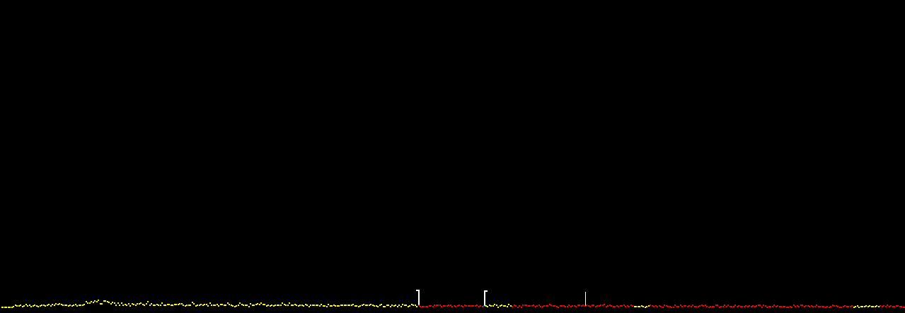
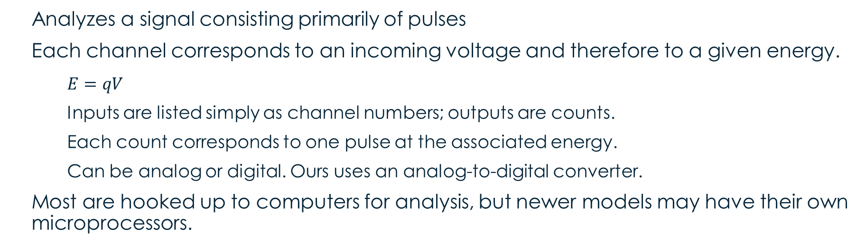
Multichannel Analyzer
Analyzes a signal consisting primarily of pulses
Each channel corresponds to an incoming voltage and therefore to a given energy.
$E=qV$
Inputs are listed simply as channel numbers; outputs are counts.
Each count corresponds to one pulse at the associated energy.
Can be analog or digital. Ours uses an analog-to-digital converter.
Most are hooked up to computers for analysis, but newer models may have their own microprocessors.
Pulse Height Analyzer: Mode that sorts pulses according to amplitude
Multichannel Scaler: Mode that sorts pulses by time of arrival.
Sample output from the Multichannel Analyzer. (Control Data)

Slide 6
Linear Regression

Slide 7
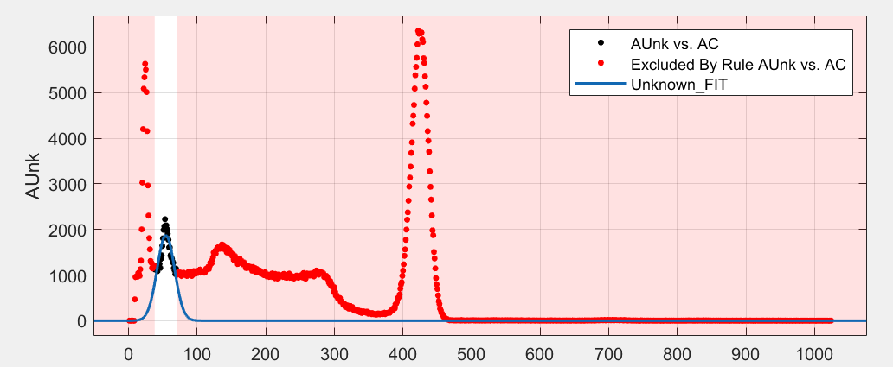
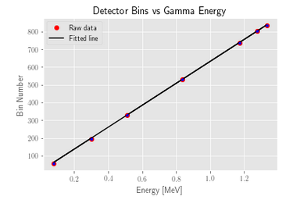


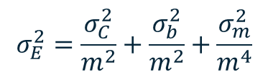

Error Propagation
Step 1: Finding bins for known values – uncertainty is given in MATLAB based on χ².
Step 2: Calibration Curve – uncertainty is given in Python by a covariance matrix based on a weighted curve fit.
Energy [MeV] | Uncertainty [MeV]
0.670 | 0.007
0.024 | 0.007
0.072 | 0.007
1.16 | 0.01
Step 3: Final Value – uncertainty is calculated by hand.
$$E=621C+9$$
$$σ^{2}=Σ{\left(σ_{i}\frac{df}{di}\right)}^{2}$$
$$E=\frac{C−b}{m}$$
$$σ_{E}^{2}=\frac{σ_{C}^{2}}{m^{2}}+\frac{σ_{b}^{2}}{m^{2}}+\frac{σ_{m}^{2}}{m^{4}}$$
0.662 [MeV]: ¹³⁷Cs. 0.511, 1.115[MeV]: ⁶⁵Zn

Slide 8
Further Reading
AMTEK Inc. (2015). Multichannel Analyzers. Retrieved from Ortec: https://www.ortec-online.com/products/electronics/multichannel-analyzers-mca
Gammma Energies. (n.d.). Retrieved from cpp.edu: https://www.cpp.edu/%7Epbsiegel/bio431/genergies.html
Multichannel Pulse Analysis. (n.d.). Retrieved from http://faculty.kfupm.edu.sa/phys/aanaqvi/NaqEmploy_files/Text%20ch18-20%20GK%20Radiation-text.pdf
Nuclear Power for Everybody. (2019). Interaction of Gamma Radiation with Matter. Retrieved from Nuclear Power: https://www.nuclear-power.net/nuclear-power/reactor-physics/interaction-radiation-matter/interaction-gamma-radiation-matter/
Physics 359E. (n.d.). The Multichannel Analyzer. http://www.astro.uwo.ca/~jlandstr/p359/writeup/mca.pdf
The Editors of Encyclopedia Brittanica. (2019). Gamma Decay. Retrieved from Encyclopedia Brittanica: https://www.britannica.com/science/gamma-decay
webmaster. (2000, August 9). Beta Decay. Retrieved from Guide to the Nuclear Wallchart: https://www2.lbl.gov/abc/wallchart/chapters/03/2.html
Yokamika, R. (2016, January 11). Formula for Gamma Radiation. Retrieved from Gamma Radiation: http://gammaradiationjishikuza.blogspot.com/2016/01/formula-for-gamma-radiation.html

